Slide 1

Smals: inhouse expertise supporting reuse and collaboration for better eGov services

Slide 2

Smals and the ReUse initiative
Short presentation of Smals
The ReUse initiative
  What is it?
  What do we want to achieve ?
  Enablers to achieve our goals
  How does it work ?
  What are the benefits ?
  Some results
  What’s next: European perspective
ReUse and collaboration for better eGov services

Slide 3
Smals

Slide 4
Statutory mission and some figures
Founded in 1939 as a not-for-profit association of Belgian social security institutions for delivering in-house expertise and consulting; restructured in 2004
Statutory mission: “Smals supports and assists social security and healthcare institutions - and other public services on their demand - in their information management so that they can provide effective and efficient services to their users. Smals offers in-depth knowledge and skills, to generate mutually beneficial economies of scale and to drive additional value creation, while stimulating ICT reuse”
Member institutions are free to choose whether they wish to use Smals' services (no monopoly)
2,150 employees – huge cooperation with private sector (> 1,000 external experts)
Annual turnover 500 million euro’s
See https://www.smals.be/fr

Slide 5
Legal framework
Companies and associations code
Article 17bis Crossroads Bank for Social Security (CBSS) Act
  for the authorisation of association of public institutions
  for the obligatory not-for-profit form
  for the principle of cost-sharing
  for the legal authorisation of secondment of specialised staff
Article 30 Public Procurement Act
  for the possibility of direct assignment of contracts by the members ('in-house‘ construction)
Article 2, 1°, c) Public Procurement Ac
  for the subjection of Smals to the Public Procurement Act

Slide 6
Governance
General Assembly
  all members (> 300)
  3 categories with degressive voting rights according to importance/contribution, grosso modo
    A: Public Social Security & Health Institutions
    B: Federal Public Services & Federated Entities
    C: Public Centers of Social Welfare
Governance board
  20 directors, nominated by
    Category A, B and C members: 11, 2 and 1 directors respectively
    General Assembly as a whole: 4 directors
    Minister for Social Affairs: 1 director
    Minister of the Budget: 1 director
Strategic Committee
  11 directors
  Executive Committee
Audit Committee, reporting to the Governance Board
  6 directors
  3 external members

Slide 7
Control
Members (essence of 'in-house‘ construction)
  directly through the General Assembly (appointment of directors, budget, costing, accounts, etc.)
  indirectly through the Governance Board
  are themselves public institutions or government departments under the authority of a minister
  the 2 ministers (through nominated directors)
Internal procedures, including
  internal audit department
  risk management
  strategic objectives
Company auditor
Court of Audit
  structural cooperation on finance and thematic studies, e.g. public procurement

Slide 8
Portfolio
Applications
  Supporting development of digital strategies
  Business analysis
  Business Process Reengineering (BPR)
  Software development
  Methodology
  Reusable components
  Data quality
  Usability
  Information security
  Mobile device management
  Web development
  Operations
  Change management
R&D
Infrastructure
  Data center services
  Hosting
  Information networks
  Server infrastructure
  Storage services
  ITIL framework
Support services
  CRM
  Communication agency (Bucom)
  Contact center (Eranova)
  Print & mail
  Framework contracts
Staffing

Slide 9
Some achievements
Contributes significantly to G-Cloud and software reuse
Cost sharing facilitates collaboration between public institutions (data center, portals, user management, 24/7 monitoring of services, etc.).
Generates economies of scale
Provides institutions with hard-to-find expertise on ICT and information security
Offers expertise in ICT public procurement, facilitating access of private ICT service providers to the public sector
Stimulates innovation thanks to small R&D department (see https://www.smalsresearch.be/)

Slide 10
International level
World Health Organisation
World Bank
EU
  Electronic Exchange of Social Security Information (EESSI)
  European Social Security Pass (ESSPass)
  European Blockchain Services Infrastructure (EBSI) (My health @ EU)
  Electronic Identification and Trust Services (eIDAS)
  Digital Credentials for Europe (DC4EU) Consortium
  eHealth Digital Service Infrastructure (eHDSI)
  EU Digital COVID Certificate (EU DCC)
International Social Security Association (ISSA)

Slide 11


ReUse: what is it?

Slide 12


What is it?

Slide 13
What do we want to achieve?

Slide 14





To provide better
digital services to the public
Goal
Companies
Europe
Private Partners
Citizens
Belgian
Governments
Health actors
  by working together
  by sharing and reusing what already has proven to be successful
Other countries
Civil servants
Service providers
ReUse and collaboration for better eGov services

Slide 15

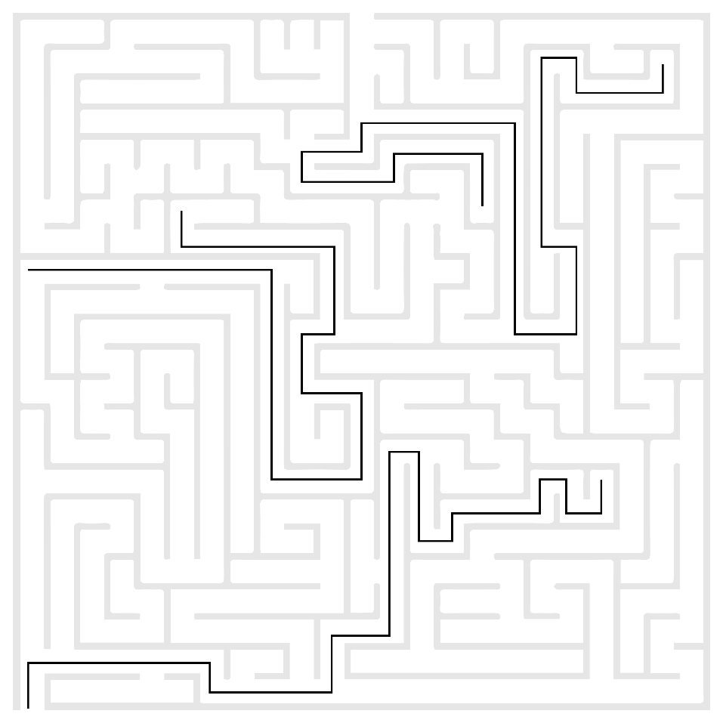


The ‘government’ is a complex ecosystem
Challenges
  The experience with the government is not always optimal
??
ReUse and collaboration for better eGov services

Slide 16

The world is
changing FAST
Challenges
  Societal challenges
  Technological challenges
  Ecological challenges …
ReUse and collaboration for better eGov services

Slide 17

Budgets are under
severe pressure
Challenges
  and skilled people are hard to find
ReUse and collaboration for better eGov services

Slide 18







Expectations of citizens & enterprises
Effective services
Integrated services
With a minimum of costs and administrative formalities
Provided automatically, if possible
Reliable, safe and permanently available
ReUse and collaboration for better eGov services

Slide 19




Expectations of citizens & enterprises
With active user participation
Offered in a performant and user friendly way
Using the media of their choice
Adjusted to their own processes
Respecting their privacy
ReUse and collaboration for better eGov services

Slide 20
Enablers to achieve our goals

Slide 21
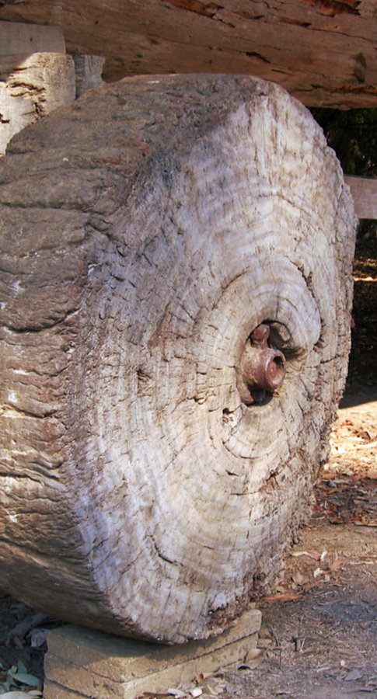
Let’s NOT reinvent the wheel…
Share and reuse existing assets
  Business processes
  Software components and API’s
  Procurement and licences
  Infrastructure
  Other types of building blocks…
ReUse and collaboration for better eGov services

Slide 22

Let’s work together…
Align and collaborate
  Promote and rely on mature business concepts
  Enforce proven standards
  Share knowledge and techniques
  Exchange good practices
  Co-creation with all actors involved
ReUse and collaboration for better eGov services

Slide 23






























Who is already involved?
FEDERAL PUBLIC SERVICE
Employment, Labour and
Social Dialogue
And many more…

Slide 24
How does it work?

Slide 25
Some initiatives
ICT infrastructure: G-Cloud initiative launched in 2015
  Focus on hardware, infrastructure services, platforms…
Software: ReUse program for public institutions accelerated in 2019
  Focus on components, authentic data sources, API’s
Full stack: Enterprise Architecture approach across institutions since 2021
  Focus on architectural principles, processes, building blocks, …
Near future: Public cloud computing ?
  Sufficiently secure, multi-vendor use
  Strong governance, avoiding lock-in
ReUse and collaboration for better eGov services

Slide 26

G-Cloud – Sharing ICT infrastructure
Program of synergy-driven projects
  Strong participation of private sector suppliers
Joint government ICT platform
  Mainly federal
  Expandable to other governments if interested
Hybrid community cloud model
  Reliance on public cloud where possible
  Partly private community cloud running from government-managed datacenters
  Operational implementation with broad reliance on external suppliers
ReUse and collaboration for better eGov services

Slide 27
G-Cloud – Sharing ICT infrastructure
G-Cloud = coalition
  G-Cloud ≠ central organization
Governance
G-Cloud service
Offered by
Service owner
Delivered by
Service provider
ReUse and collaboration for better eGov services

Slide 28
G-Cloud – Sharing ICT infrastructure
Government
G-Cloud Operations & Programme Board
G-Cloud Strategic Board
FPS
(Horizontal FPS, FPS FIN, Belnet, …)
PSSI/IPB
(CBSS, ...)
Association of FPS/PSSI/IPB
Private ICT companies directed by FPS/PSSI/...
3 Colleges
Federal Public Services (FPS)
Public Social Security Institutions (PSSI)
Institutions of Public Benefit (IPB)
SIT: ICT managers from
Federal Public Services (FPS)
Public Social Security Institutions (PSSI)
Institutions of Public Benefit (IPB)
Service
owners
ReUse and collaboration for better eGov services

Slide 29
G-Cloud – Sharing ICT infrastructure
Horizontal software (Solutions)
Website - HR - Finance - Access Control - …
Application platforms
Soft infrastructure
Virtualisation - Security - E-mail - VoIP - …
Hard infrastructure
Computing - Network - Storage
ReUse and collaboration for better eGov services

Slide 30
G-Cloud – Sharing ICT infrastructure
www.gcloud.belgium.be

Slide 31

Sharing infrastructure – software – business components
Business components
Core business (declarations, administrative processes, …)
+
SHIFT
SHIFT
Horizontal software (Solutions)
Website - HR - Finance - Access Control - …
Application platforms
Soft infrastructure
Virtualisation - Security - E-mail - VoIP - …
Hard infrastructure
Computing - Network - Storage

Slide 32
Reuse of software & business components
Initiative
  Orginated within Belgian public social security institutions & Smals
  Open to federal public services & other
Purpose
  Synergy around (technical) business components
  Save costs by avoiding multiple development of redundant components
Regardless of whether development takes place by
  The institution's own ICT department
  Smals
  Subcontractors
How ?
  Consult the catalogue of reusable components and get in contact with networks
ReUse and collaboration for better eGov services

Slide 33



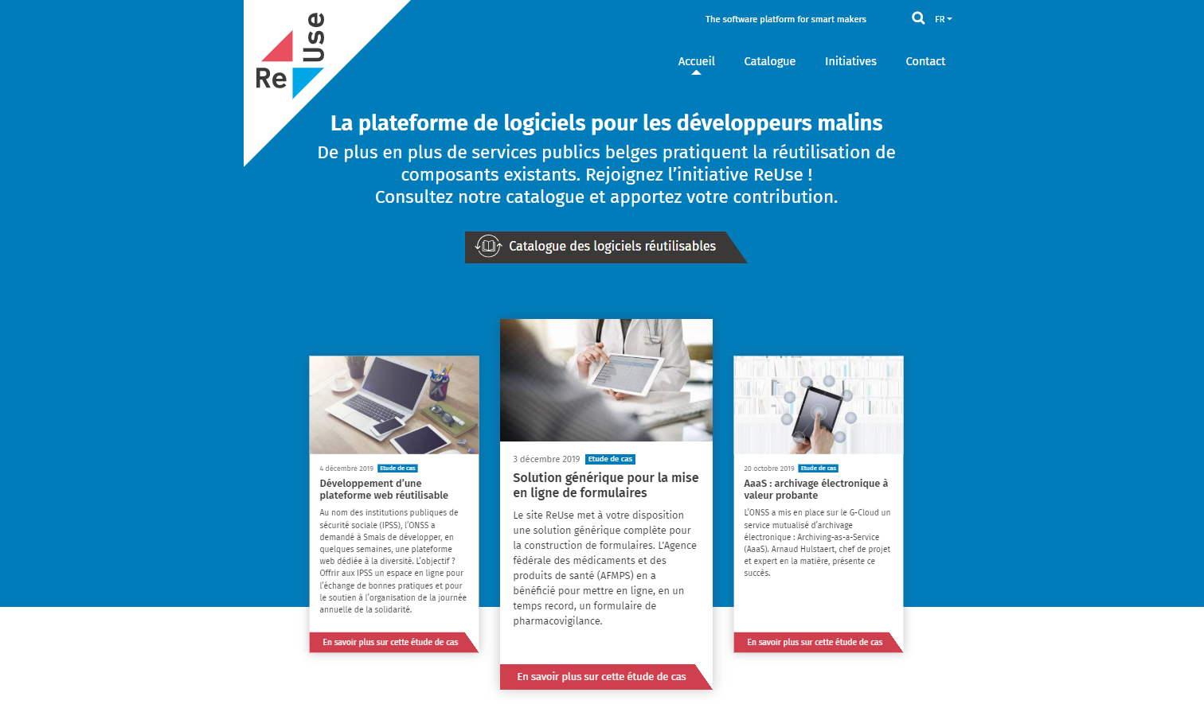
Software reuse – how does it work?
Network A
Governance by the ReUse Competency Center
Quality Assurance based on
Enterprise Architecture principles
Project 2
Project 3
Knowledge &
expertise
Project 4
Project 1
Network C
Software Reuse Catalog
reuse
offer reusable
consult & align
Network B
104 components and counting….
Project X
Knowledge &
expertise
Knowledge &
expertise
www.ict-reuse.be
info@ict-reuse.be
Project 5
Project 6

Slide 34
Software reuse – how does it work?
Take aways
  Make visible what already exists
  Integrate reuse in the project life cycle
  Measure the benefits (ROI)
  Use networks to detect missing components or future opportunities
  Provide mature governance around reusable components
And most of all… dare to share!
  Learn fast & adjust (and don’t give up too easily)
ReUse and collaboration for better eGov services

Slide 35
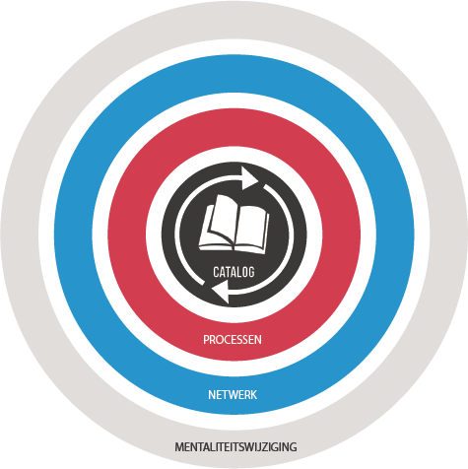
ReUse – Vision
Every stakeholder
can easily find the most common reusable elements in a centralized catalogue
Processes
and tools are put in place to identify, register, implement, monitor and measure reuse throughout the project lifecycle
Human
networks are maintained and developed on all levels (CEO’s, CIO’s, business owners, business analysts, architects) in order to keep maximum visibility on reuse potential
A culture
develops where
reuse is adopted and the creation of reusable products is promoted,
35

Slide 36
Building blocks for a “generic public service”
(Partial view)
Request / declaration
Forms / Batch
Data flows
Incoming / outbound
Webservices / batch
Communications
Archiving
Support services
Procurement
Human resources
Translation services
Legal
Logistics
Communications
Helpdesk
Forms
DSP - Document Service Provider
Document Orchestration Service
e-Box - Electronic mailbox
Govapp
PrintManager
AAAS - Archiving-as-a-Service
Multifunctional declarations
API Gateway
Payments received
Automated data treatments
Call center
Supporting software
Office automation
eMail / telephony
Basissystemen
eAcademy
Management of commitees
Coda reader
Event notifications
Sepia document signer
Timestamping
Data quality tools
CMS - Web Content Management System
CSAM – Log on to online public services
Identity and Access Management
User Access Management
Payments
Case management
Reporting
Process management
Task management
Work environment
BI Platform

Slide 37


Public & private sector opportunities
The government is NOT an island
Invitation to private sector parties to get involved
ReUse and collaboration for better eGov services

Slide 38





Public & private sector opportunities
Existing,
Valuable
Services
Made available as APIs
Self service use
by developers
To create new innovative apps and services
Differentiated services,
Better experience
ReUse and collaboration for better eGov services

Slide 39



Enterprise Architecture : framework
Holistic
Vision & strategy
Vertical
Domains
Social security
Health
Other
Customer Centricity
Only Once
Employment
Illnes
Health care
Taxes
…
Services
Holiday
Pension
Medical costs
Family allowance
Care
Health risks
Medicines
Defense
Mobility
Horizontal
Processes
Generic & reusable
Interopera-bility
Architectural-principles
Building Blocks
Generic & reusable
Standards
Legacy vs innovation
Privacy by design

Slide 40
What are the benefits ?

Slide 41




What are the benefits of a reuse mindset and more collaboration?
Faster | Flexible
Cheaper | Higher maturity
ReUse and collaboration for better eGov services

Slide 42

Benefits
Improving quality of
life for citizens and enterprises
ReUse and collaboration for better eGov services

Slide 43
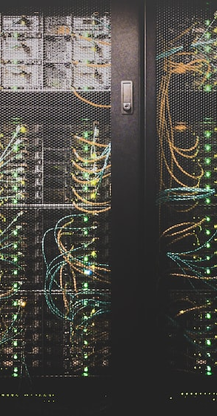
Offering excellence in digital services
Benefits
  Reliability
  Performance
  Added value
ReUse and collaboration for better eGov services

Slide 44

Some results

Slide 45


Results
53%
65%
ROI
10%
Reused
reusable
Business specific
custom code:
25%
Average ROI / ReUsed component (2019) : € 27.000
Total ROI 2023 (Projects by Smals, approx.): € 45.000.000
ReUse and collaboration for better eGov services

Slide 46
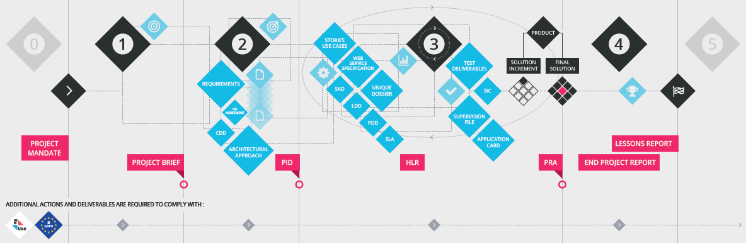
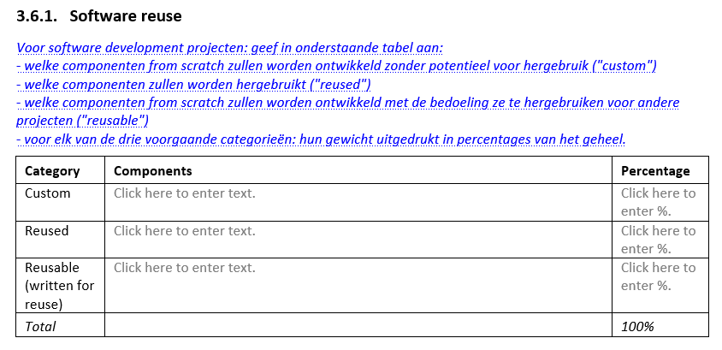
ReUse is part of project lifecycle
4
1
2
3
5
Standard project methodology @Smals
  Detect ReUse opportunities as soon as possible
  ReUse embedded in Project Lifecycle

Slide 47
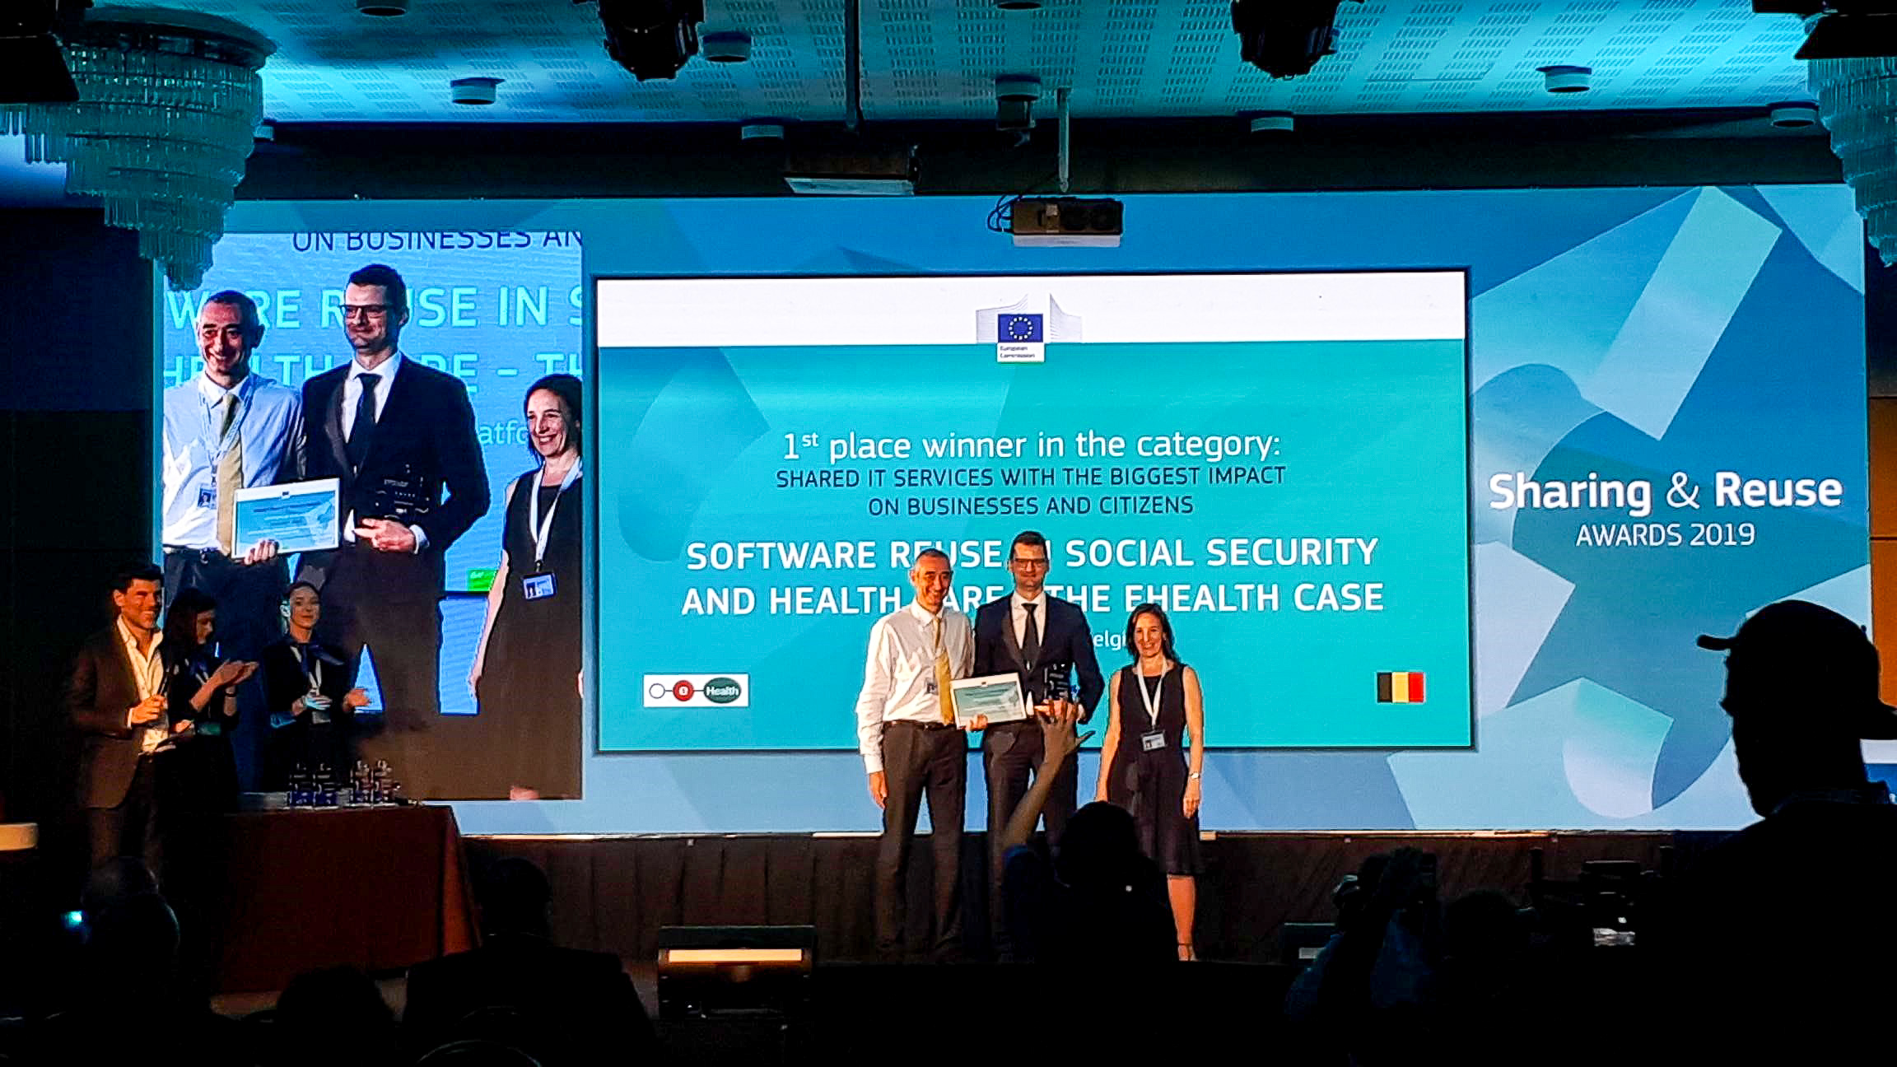

EU Sharing & ReUse Award
EU Sharing & ReUse Awards – 2019
  Shared IT services (commonly developed or shared)
  with the biggest impact on citizens or businesses
  Winner: eHealth-platform & Belgian social security
ReUse and collaboration for better eGov services

Slide 48

What’s next ?

Slide 49

European context
Interoperable Europe Act
  Secure cross-border exchange & interoperability
Open Data Directive
  High value datasets to be made available for re-use
EU Health Data Space
  Interoperability & security
  Strong regulation needed
  Share best practices – Sumehr, ePrecription…
JoinUp initiative
  joinup.ec.europa.eu
ReUse and collaboration for better eGov services

Slide 50
European context
eIDAS – v2
  New: Quality Attributes
  Still missing: Relationships (ex. Therapeutic)
EU Health Insurance Card
EU Digital Identity Wallet
  DC4EU Consortium - www.dc4eu.eu
ReUse and collaboration for better eGov services

Slide 51






frank.robben@mail.fgov.be
@FrRobben
www.frankrobben.be
www.gcloud.belgium.be
www.smals.be
Subscribe here
www.ict-reuse.be
info@ict-reuse.be
x.com/ictreuse
www.linkedin.com/company/reuse-ict/

