Slide 1
Proper digitisation as a critical success factor for effective and efficient social protection and health care

Slide 2
About me (°1961)
education: law, ICT, ICT auditing, management, personal coaching
professional activities
  Crossroads Bank for Social Security
    1986-1991: originator as an advisor to the Minister of Social Affairs and the Prime Minister
    since 1991: CEO
  Data Protection Authority
    1991-2022: external member
  Federal Ministry of ICT
    2000-2001: originator as an advisor to the Minister of ICT (ao conception of electronic identity card)
  Smals (non for profit operational ICT association of public institutions of social security and health)
    since 2004: CEO (ao originator of G-Cloud initiative)
  eHealth platform
    2007-2008: originator as an advisor to the Minister of Public Health
    since 2008: CEO
    2020-2021: enterprise architect of Belgian information systems to fight the COVID-19 pandemic (testing, tracing, vaccination) and contributor to development of components on EU and WHO level

Slide 3
Setting the scene

Slide 4


Slide 5


Slide 6


Slide 7
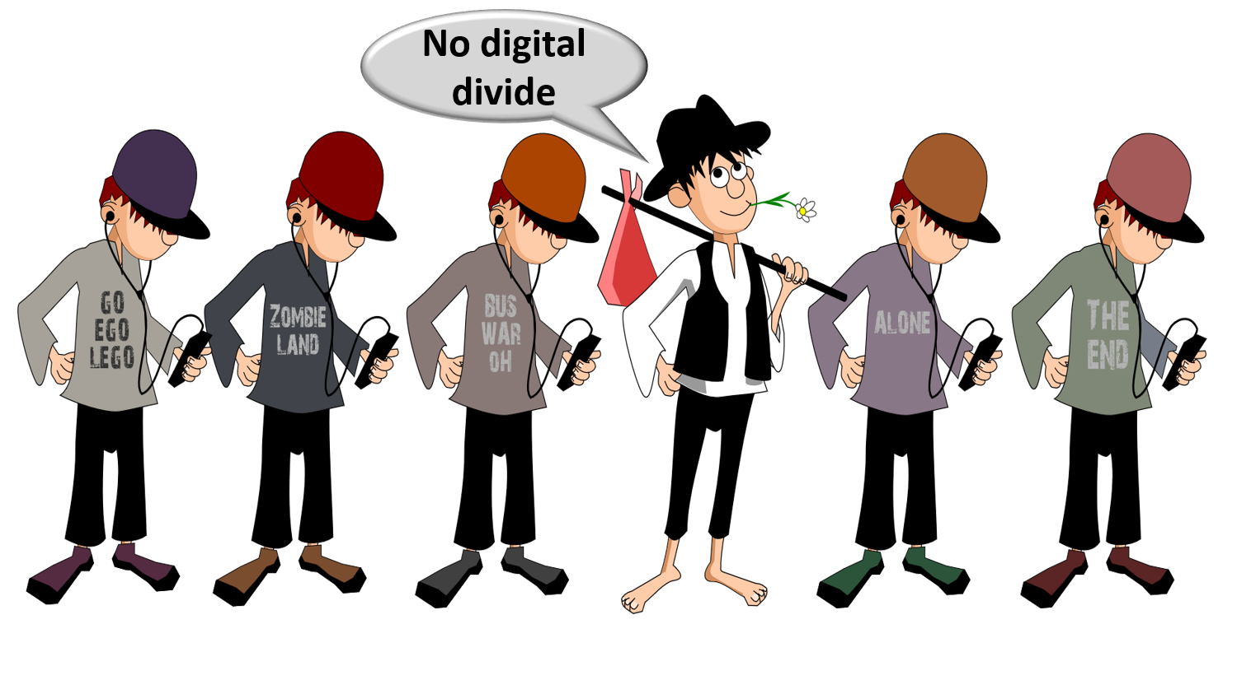

Slide 8


Slide 9


Slide 10


Slide 11


Slide 12


Slide 13


Slide 14
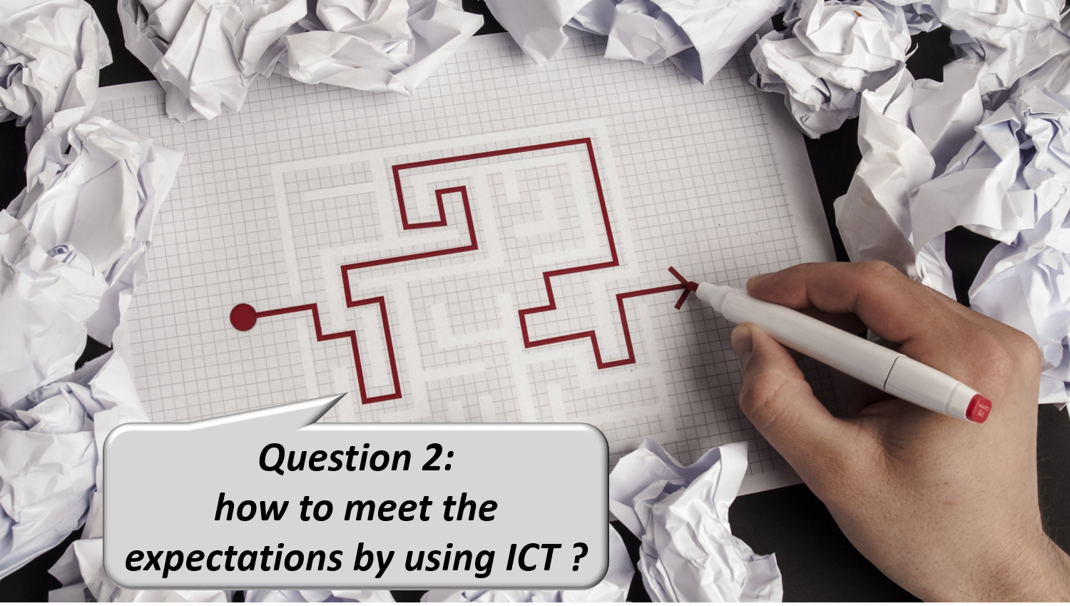

Slide 15


Slide 16


Slide 17


Slide 18


Slide 19
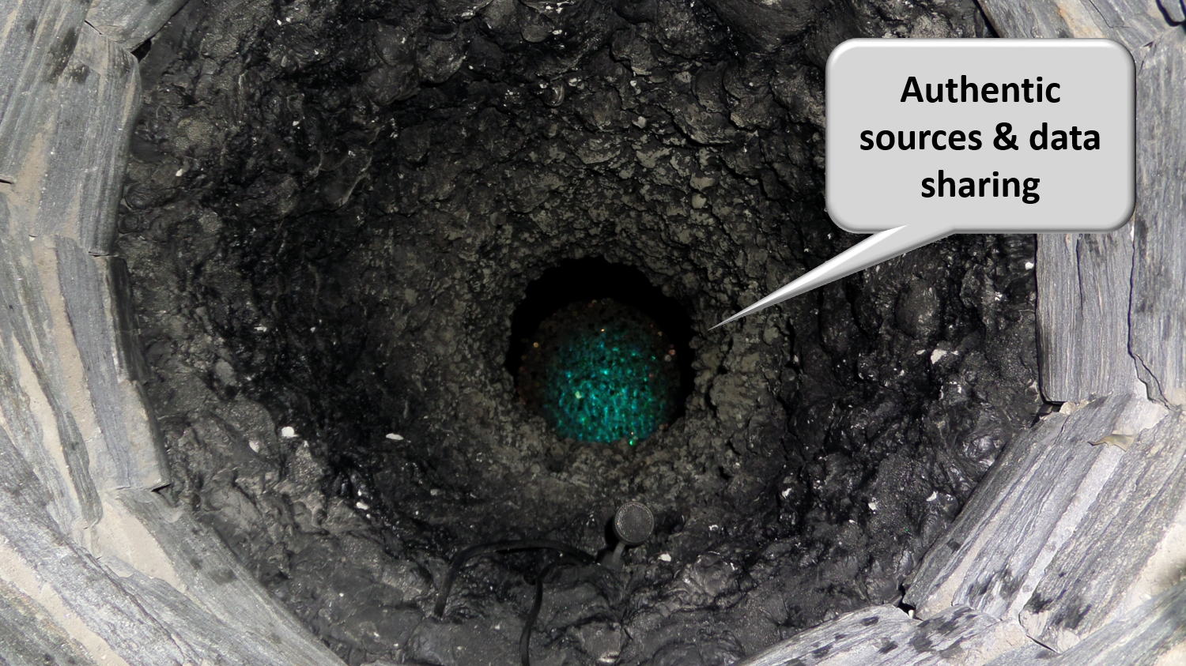

Slide 20


Slide 21


Slide 22


Slide 23


Slide 24
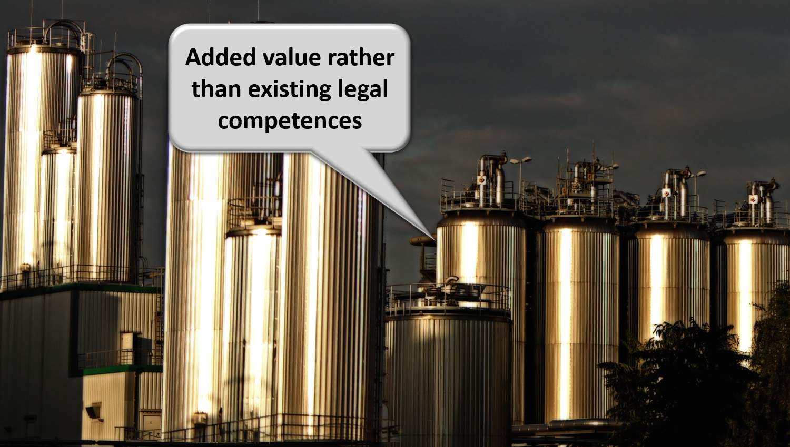

Slide 25


Slide 26
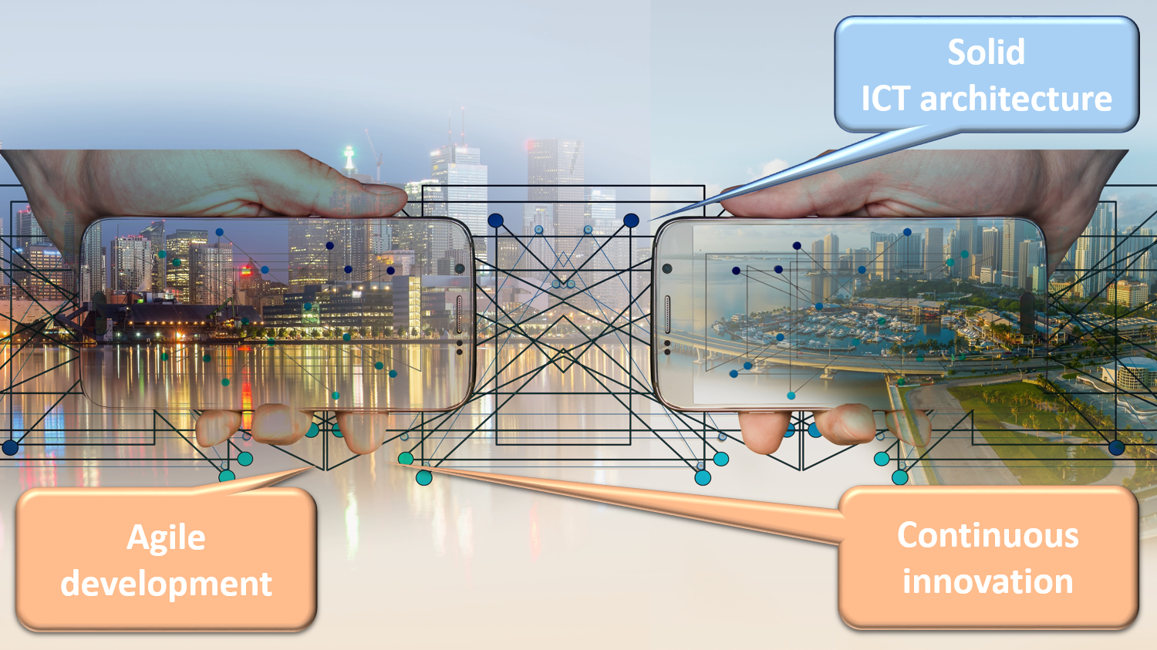

Slide 27
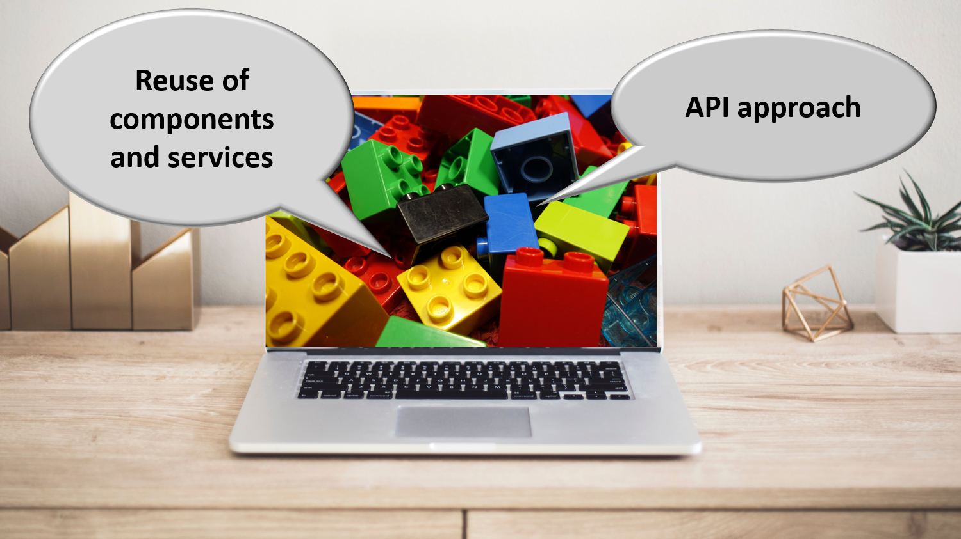

Slide 28
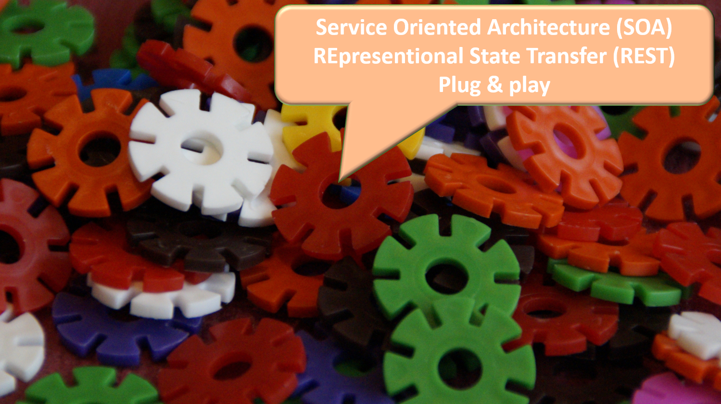

Slide 29
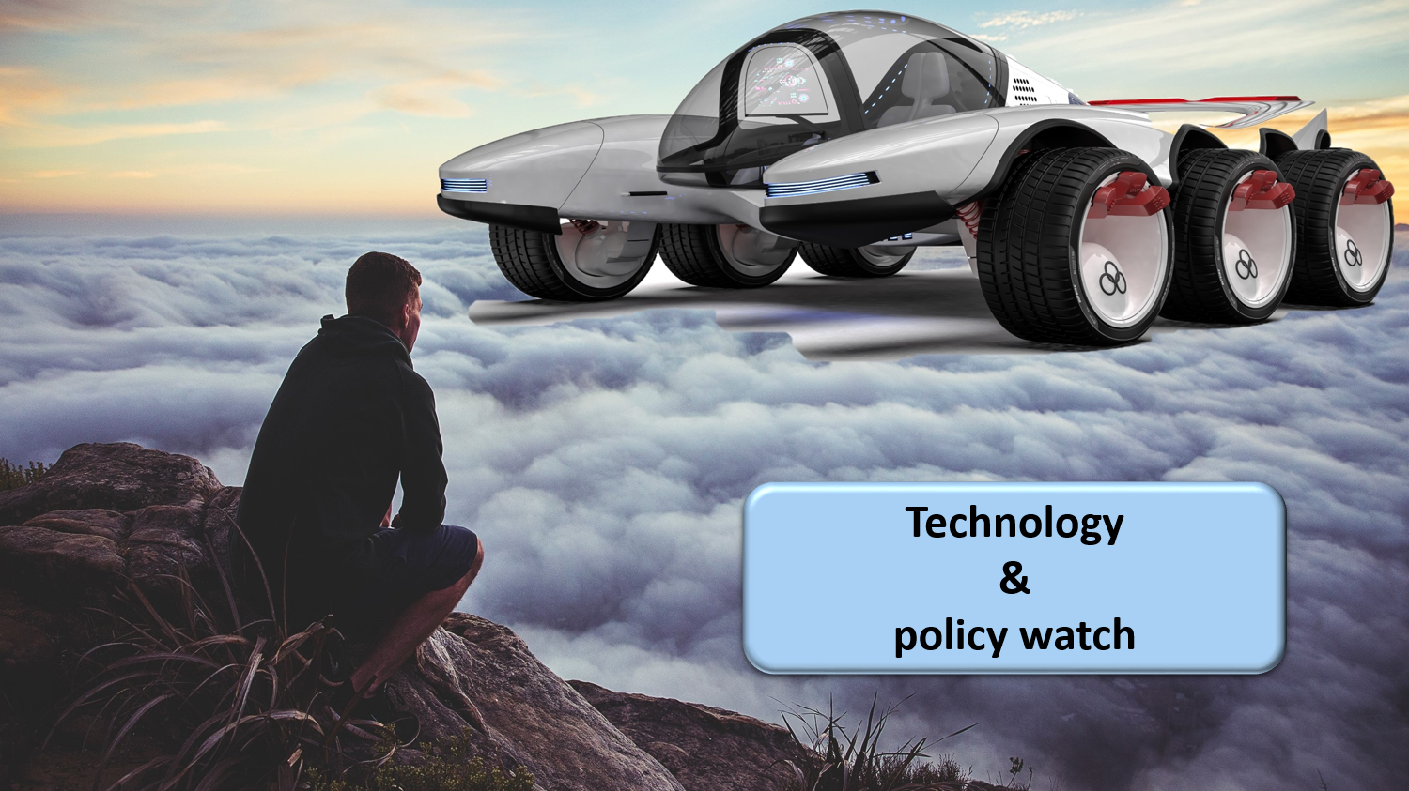

Slide 30


Slide 31


Slide 32
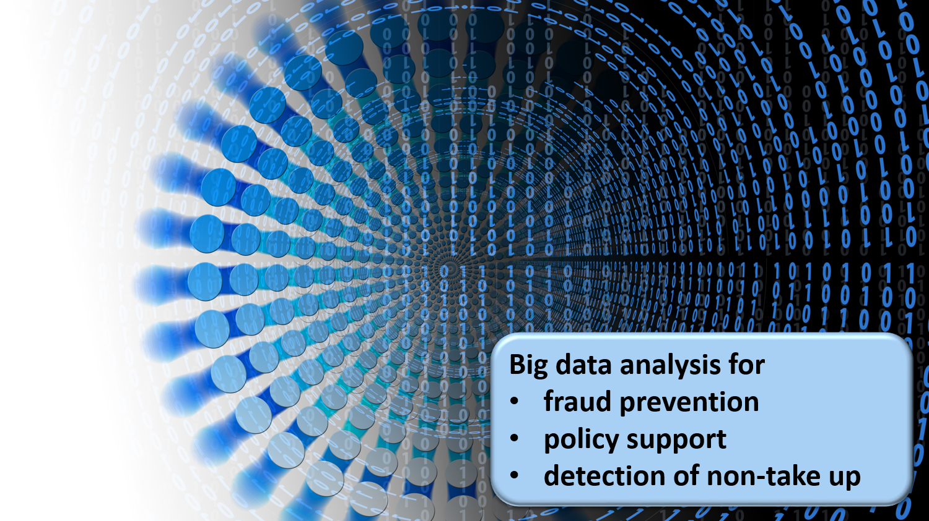

Slide 33
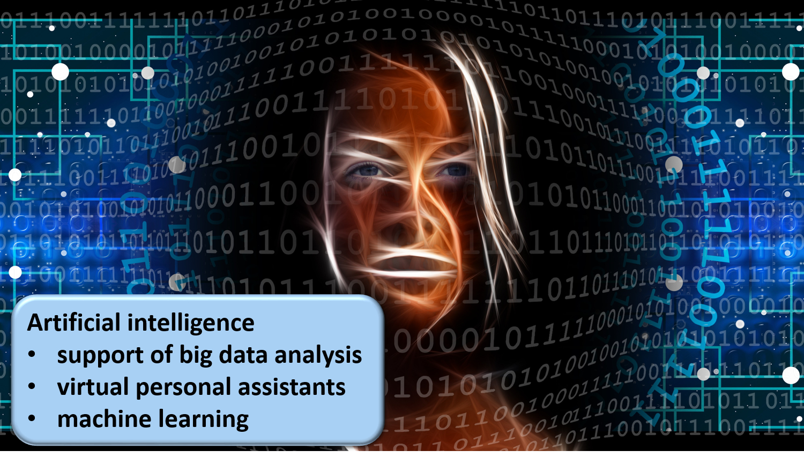

Slide 34


Slide 35

Notes:
Let the computer do what it is good at and thereby make time available for human support where necessary. And remember: the network always wins

Slide 36
Application in the Belgian social sector

Slide 37
Stakeholders of the Belgian social sector
> 11,700,000 citizens
> 230,000 employers
about 3,000 public and private institutions (actors) at several levels (federal, regional, local) dealing with
  collection of social security contributions
  delivery of social security benefits
    child benefits
    unemployment benefits
    benefits in case of incapacity for work
    benefits for the disabled
    re-imbursement of health care costs
    holiday pay
    old age pensions
    guaranteed minimum income
  delivery of supplementary social benefits
  delivery of supplementary benefits based on the social security status of a person

Slide 38
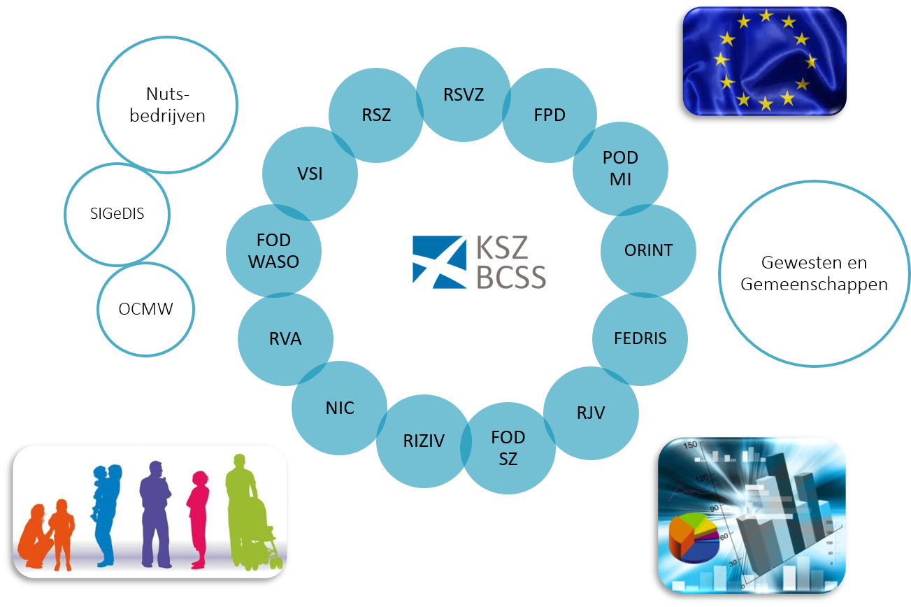
Kruispuntbank van de Sociale Zekerheid (KSZ)

Slide 39
Crossroads Bank of Social Security (CBSS)
Internet
R
FedMAN
Users
R
Isabel
FW
R
…
R
Backbone
FW
FW
FW
FW
FW
R
R
R
R
R
RVA
KSZ
RSZ
R
R
NIC
…

Slide 40
Results
no central data storage, but an agreed division of tasks between the actors within and outside the social sector with regard to collection, validation and management of information and with regard to electronic storage of information in authentic sources
a network between all 3,000 social sector actors with a secure connection to the internet, the federal MAN, regional extranets, extranets between local authorities and the Belgian interbanking network
a unique identification key
  for every citizen
  for every company
  for every establishment of a company

Slide 41
Results
220 electronic services for mutual information exchange amongst actors in the social sector, defined after process optimization
  nearly all direct or indirect (via citizens or companies) paper-based information exchange by > 800 paper forms between actors in the social sector has been abolished
  in 2023, > 1,81 billion electronic messages were exchanged amongst actors in the social sector, which saved as many paper exchanges
electronic services for citizens
  maximal automatic granting of benefits based on electronic information exchange between actors in the social sector
  29 electronic services via an integrated portal and/or mobile applications

Slide 42
Maximum automatic granting of additional rights
‘social statute' for about 2 million citizens in Belgium
  limited income
  handicap, physical or mental disability
  child with special needs
citizens with social statute receive 'additional rights‘
  social rate for gas, electricity, water, telecom
  public transport
  housing
  tax reduction, free waste collection
  reduction for socio-cultural activities, sports
  ...
2

Slide 43
Principles
factual information available from one or more actor(s) is made available to other actors who, on that basis, automatically grant rights to the citizen without him/her having to submit an application for this
standardized services to respond as much as possible to information requests and avoid/reduce multiple developments, both for the data providers (authentic sources) and for the entities granting benefits
reduction in
  the number of statutes used and their complexity
  data exchanges
  the number of administrative formalities and paper certificates requested from this vulnerable population group
5

Slide 44
Lego brick philosophy
Authentic source (NR & CBSS)
Date of birth
Residence
Family composition
Social statutes
Public Social Security Institutions
Additional right
Granting authority
Income guarantee for elderly
Elderly care budget
Guaranteed income
…
Reduction of provincial tax
Province of East Flanders
Public Social Welfare Centers
Living wage
Equivalent living wage
Ministries
Integration allowance disabled people
…
Sickness funds
Income
Increased healthcare costs allowance

Slide 45
Lego brick philosophy
Authentic source (NR & CBSS)
Date of birth
Residence
Family composition
Social statutes
Public Social Security Institutions
Additional right
Granting authorities
Income guarantee for elderly
Elderly care budget
Guaranteed income
…
Social rate for gas & electricity
FPS Economy & utility companies
Public Social Welfare Centers
Living wage
Equivalent living wage
Ministries
Integration allowance disabled people
…
Sickness funds
Income
Increased healthcare costs allowance

Slide 46
MyBenefits
mobile app & web application
which allows citizens to consult and prove their social statuses on the date of the day itself in order to assert their rights with the various authorities that grant additional benefits
which allows the awarding authority to verify the social statutes
    actors who typically do not cooperate directly with the CBSS (e.g. sports, child care, museums, leisure centers, amusement parks, etc.)
    actors who do not (yet) have an automatic data flow (e.g. pro bono legal assistance, municipal tax reduction, ...)
which allows authorities granting additional benefits in the culture, sports and entertainment sector to report them, and citizens to consult them

Slide 47
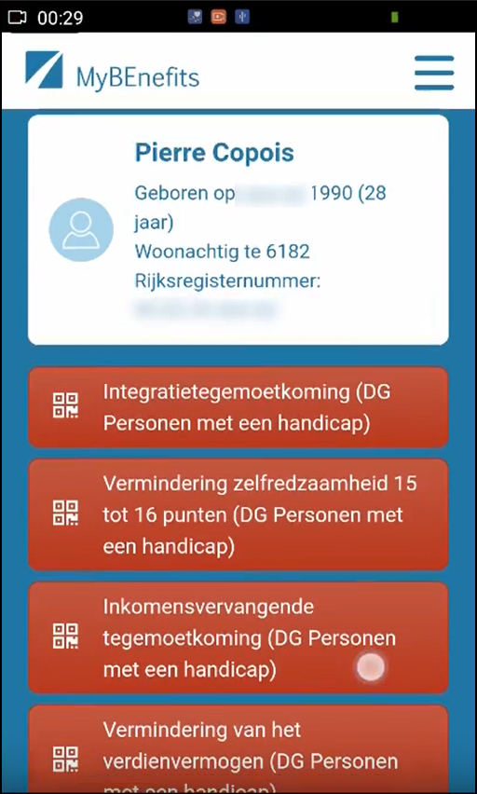
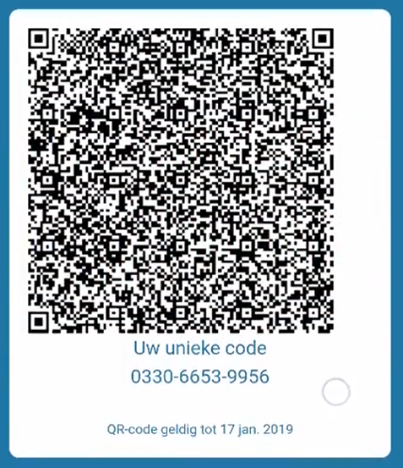
Citizen - consult & create code

Slide 48
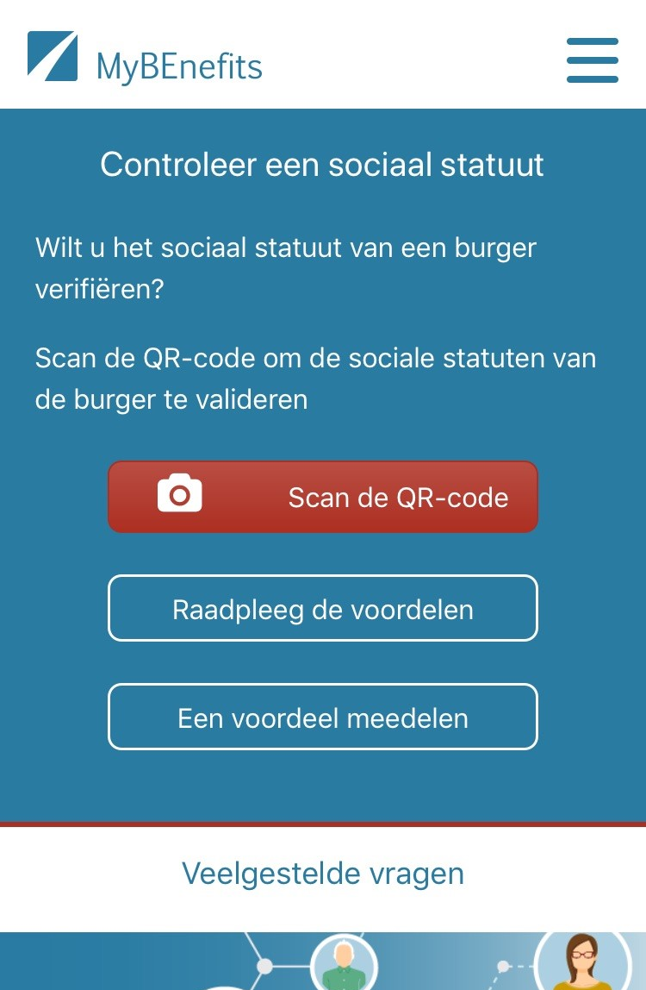
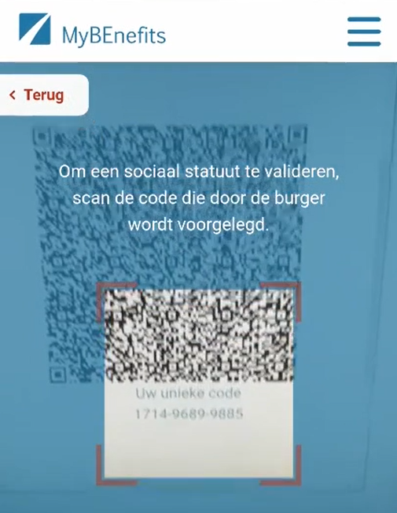
Professional - consult

Slide 49
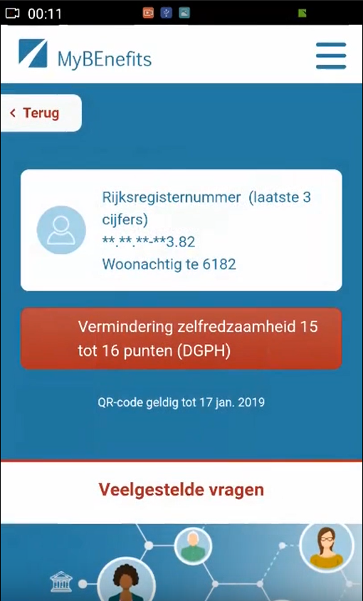
Professional - result

Slide 50


Slide 51
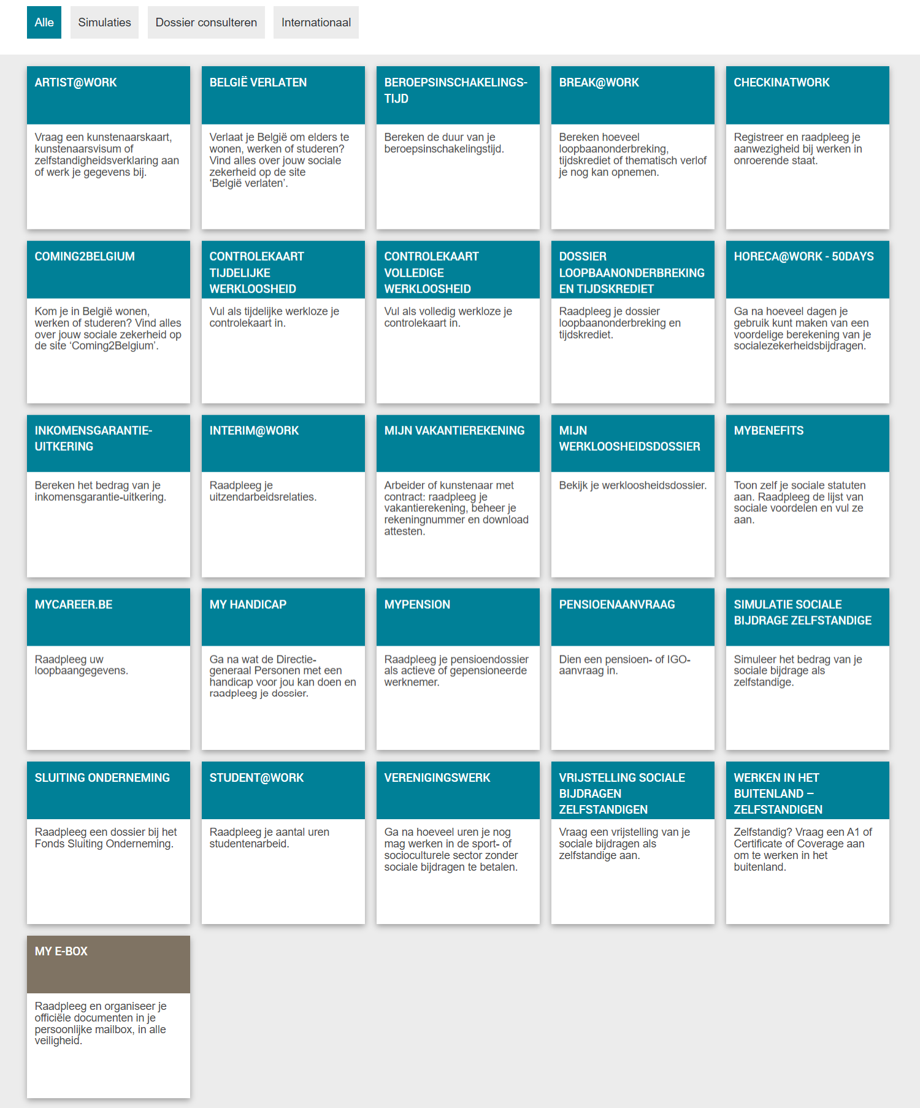
Social security portal for citizens

Slide 52
Results
more than 50 electronic services for employers, either based on the electronic exchange of structured messages or via an integrated portal site
  50 social security declaration forms for employers have been abolished
  in the remaining 30 (electronic) declaration forms the number of headings has on average been reduced to a third of the previous number
  declarations are limited to 3 events
    immediate declaration of recruitment and discharge (only electronically)
    quarterly declaration of salary and working time (only electronically)
    occurrence of a social risk (electronically or on paper)
  in 2023, more than 45 million electronic declarations were made by all 230,000 employers, 98 % of which from application to application

Slide 53









Quartely declaration salary & working time
simplification
Activity 3
Activity 2
Activity 1
employer
one electronic
declaration
RSZ
RIZIV
RVA
old age pension
FPD
Orint
holiday pay
RJV

Slide 54
Declaration of social risks
types of social risks
  child benefits
  incapacity for work ((labour) accident, (occupational) disease, …)
  unemployment
  old age pension
3 possible moments of declaration
  start of the social risk
  recurrence or continuation of the social risk
  end of the social risk
structure of the declaration
  identification data
  if necessary, salary and working time data not yet declared via a quarterly declaration (mini-declaration)
  specific data concerning the social risk

Slide 55
Results
an integrated portal site and mobile applications containing
  electronic transactions for citizens, employers and professionals
  simulation environments
  information about the entire social security system
  harmonized instructions and information model relating to all electronic transactions
  a personal page for each citizen, each company and each professional
an integrated multimodal contact centre supported by a customer relationship management tool
a data warehouse containing statistical information with regard to the labour market and all branches of social security

Slide 56
Distributed information servers
information servers
  directory of data subjects at the KSZ
  basic identification data of citizens at the National Register and the complementary KSZ Register
  basic identification data of companies at the Company Register
  employers directory (WGR) at the RSZ
  work force register at the RSZ
  salary and working time database at the RSZ
  database of contribution certificates
services offered
  interactive consultation
  batch consultation
  automatic communication of updates

Slide 57
Pre-processed messages
pre-processed messages
  beginning/end of labour contract, beginning/end of self-employed activity
  contribution certificates medical care (employees, self-employed, beneficiaries of social security allowances)
  unemployment benefits
  benefits in case of career break
  benefits in case of incapacity for work ((labour) accident, (occupational) disease)
  reimbursement of health care costs
  child benefits
  old age pensions
  holiday pay
  benefits for the disabled
  guaranteed minimum income – social welfare
  derived rights (e.g. tax reduction/exemption, free public transport, ...)
  migrant workers
  …
services offered
  interactive consultation
  batch consultation
  automatic communication of messages

Slide 58
Useful tool: the reference directory
reference directory
  directory of available services/information
    which information/services are available at any actor depending on the capacity in which a person/company is registered at each actor
  directory of authorized users and applications
    list of users and applications
    definition of authentication means and rules
    definition of authorization profiles: which kind of information/service can be accessed, in what situation and for what period of time depending on in which capacity the person/company is registered with the actor that accesses the information/service
  directory of data subjects
    which persons/companies have personal files at which actors for which periods of time, and in which capacity they are registered
  subscription table
    which users/applications want to automatically receive what information/services in which situations for which persons/companies in which capacity

Slide 59
Common vision on information management
information is being modelled
  in such a way that the model fits in as closely as possible with the real world
  in order to allow multifunctional use of information
information is collected from citizens and companies only once by the public sector as a whole
  via a channel chosen by the citizens and the companies
  preferably from application to application
  and with the possibility of quality control by the supplier before the transmission of the information
the collected information is validated once
  according to established task sharing criteria
  by the actor that is most entitled to it or by the actor which has the greatest interest in correctly validating it

Slide 60
Common vision on information management
a task sharing model is established indicating which actor stores which information as an authentic source, manages the information and maintains it at the disposal of the authorized users
information can be flexibly assembled according to ever changing legal concepts
every actor has to report probable errors of information to the actor that is designated to validate the information
every actor that has to validate information according to the agreed task sharing model, has to examine the reported probable errors, to correct them when necessary and to communicate the correct information to every known interested actor
once collected and validated, information is stored, managed and exchanged electronically to avoid transcribing and re-entering it manually

Slide 61
Common vision on information management
electronic information exchange can be initiated by
  the actor that disposes of information
  the actor that needs information
  the organisation that manages the interoperability framework
electronic information exchanges take place on the base of a functional and technical interoperability framework that evolves permanently but gradually according to open market standards, and is independent from the methods of information exchange
available information is used for
  the automatic granting of benefits
  prefilling when collecting information

Slide 62
Common vision on information security
security, availability, integrity and confidentiality of information is ensured by integrated structural, institutional, organizational, HR, technical and other security measures according to agreed policies
personal information is only used for purposes compatible with the purposes of the collection of the information
personal information is only accessible to authorized actors and users according to business needs, legislative or policy requirements
the access authorization to personal information is granted by an Information Security Committee, designated by Parliament, after having checked whether the access conditions are met
the access authorizations are public

Slide 63
Common vision on information security
every actual electronic exchange of personal information has to pass an independent trusted third party and is preventively checked on compliance with the existing access authorizations by that trusted third party
every actual electronic exchange of personal information is logged, to be able to trace possible abuse afterwards
every time information is used to take a decision, the information used is communicated to the person concerned together with the decision
every person has right to access and correct his/her own personal data
every actor in the social sector disposes of an information security officer with an advisory, stimulating, documentary and control task

Slide 64
Useful legislative changes
legal translation of
  the common vision on information management
  the common vision on information security and privacy protection
  the obligation to use unique identification keys
creation of a public institution (KSZ) that acts as a driving force
  mission and tasks
  governance
  financing principles
creation of a control committee on information security and privacy protection
probative value of electronic information storage and exchange
punishment of abuse of the system
gradually, coordination or harmonisation of basic legal concepts
gradually, adaptation of business processes set out in the law

Slide 65



Enterprise architecture on national level: framework
Holistic
Vision & strategy
Vertical
Domains
Social security
Health
Other
Customer Centricity
Only Once
Employment
Illnes
Health care
Taxes
…
Services
Holiday
Pension
Medical costs
Family allowance
Care
Health risks
Medicines
Defense
Mobility
Horizontal
Processes
Generic & reusable
Interopera-bility
Architectural-principles
Building Blocks
Generic & reusable
Standards
Legacy vs innovation
Privacy by design

Slide 66
Advantages
gains in efficiency
  in terms of cost: services are delivered at a lower total cost due to
    a unique information collection using a common information model and administrative instructions
    a lesser need to re-encoding of information by stimulating electronic information exchange
    a drastic reduction of the number of contacts between actors in the social sector on the one hand and companies or citizens on the other
    a functional task sharing concerning information management, information validation and application development
    a minimal administrative burden
  according to a study of the Belgian Planning Bureau, rationalization of the information exchange processes between the employers and the social sector implies an annual saving of administrative costs of about 1.7 billion € a year for the companies

Slide 67
Advantages
gains in efficiency
  in terms of quantity: more services are delivered
    services are available at any time, from anywhere and from several devices
    services are delivered in an integrated way according to the logic of the customer
  in terms of speed: the services are delivered in less time
    benefits can be allocated quicker because information is available faster
    waiting and travel time is reduced
    companies and citizens can directly interact with the competent actors in the social sector with real time feedback

Slide 68
Advantages
gains in effectiveness: better social protection
  in terms of quality: same services at same total cost in same time, but to a higher quality standard
  in terms of type of services: new types of services, e.g.
    push system: automated granting of benefits
    active search of non-take-up using data warehousing techniques
    controlled management of own personal information
    personalized simulation environments
better support of social policy
more efficient combating of fraud

Slide 69



frank.robben@mail.fgov.be
@FrRobben
https://www.frankrobben.be
https://www.ksz.fgov.be
https://www.ehealth.fgov.be

Slide 70
Spare slides

Slide 71
International perspective

Slide 72
Let’s not reinvent the wheel, but work together
share and reuse existing assets
  common vision on information management and information security
  data modelling
  business processes
  software components and API’s
  procurement and licences
  infrastructure
align and collaborate
  promote and rely on mature business concepts
  enforce proven semantic, technical and security standards
  share knowledge and techniques
  exchange good practices
  co-creation with all actors involved

Slide 73
Some basic international requirements
correct identification of every entity (citizens, companies, organisations, …)
correct routing of information request/provision
privacy and information security management
  user and access management
  end-to-end encryption
interoperability standards
  technical
  semantic

Slide 74
Service Oriented Architecture (SOA)
what ?
  “Service Oriented Architecture (SOA) is a paradigm for organizing and utilizing distributed capabilities that may be under the control of different ownership domains. It provides a uniform means to offer, discover, interact with and use capabilities to produce desired effects consistent with measurable preconditions and expectations. This style of architecture promotes reuse at the macro (service) level rather than micro levels (eg. objects). It also makes interconnection of existing ICT assets trivial” (OASIS Reference Group)
characteristics
  service-oriented
  modular
  interoperable (based on open standards or open specifications)
  extensible
  layered
  based on reuse of components and data

Slide 75
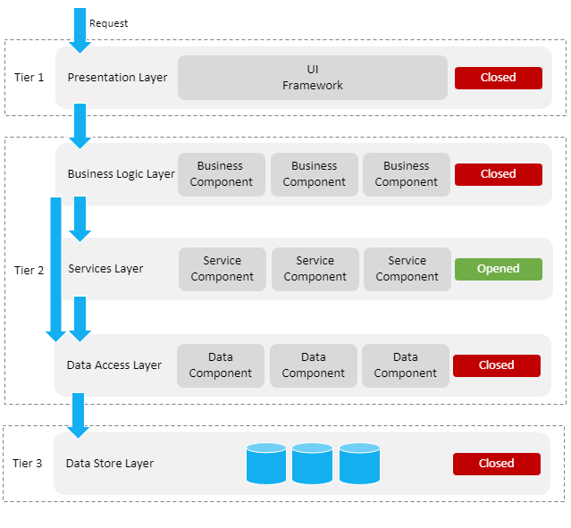
Layered, service oriented architecture
presentation layer, e.g.
  web applications
  mobile applications
business logic layer, e.g.
  workflow
services layer, e.g.
  user & access management service
  communication service
  blockchain
data store layer, e.g.
  authentic sources
  personal vaults
  local storage on mobile device

Slide 76
Across layers
interoperability standards
  technical: oa APIs (Application Programming Interface)
  semantic
security, eg
  access authorisation
  logging
  business continuity
configuration, eg
  capacity management
  load balancing

Slide 77
Advantages of layered, service oriented architecture
multifunctional reuse possibility
  lower cost
  higher quality
  quicker time to market
  better user experience
reduced dependency of components
  easier and less costly maintenance
easier unit testing because each component can be tested individually
  but need for sound integration and performance testing

Slide 78
Several EC digital programs
Electronic Identification and Trust Services (eIDAS)
European Blockchain Services Infrastructure (EBSI)
  Conformant Wallets
  Verifiable Credentials Framework
Single Digital Gateway (OOTS)
Electronic Exchange of Social Security Information (EESSI)
European Social Security Pass (ESSPass)
EU Digital COVID Certificate (EU DCC)
European Health Data Space (EHDS)
European Health Data Evidence Network (EHDEN)
...

Slide 79
Need for a global, integrated architecture
need for
  global, integrated architecture across DGs of the European Commission
  based on a common conceptual framework
need for modular, generic, domain agnostic, interoperable and reusable components/services: develop once, use many
no technology driven choice of components and services used, but use of ICT components and services as enabler and means for meeting business requirements
need for the organisation of a set of integrated services on a paneuropean level

Slide 80
Example: identity, user & access management (IUAM)
objectives to be reached: to be able to (digitally)
  identify all relevant entities (physical persons, companies, applications, machines, …)
  authenticate the identity of all entities
  know the relevant characteristics of the entities
  know the relevant relationships between entities
  know that an entity has been mandated by another entity to perform a legal action
  know the authorizations of the entities
in a sufficiently certain and secure way
in as much relations as possible (C2C, C2B, C2G, B2B, B2G, …)
multichannel (web application, mobile application, …)
using open interoperability standards

Slide 81
Policy Enforcement Model (XACML)
Action on application
DENIED
Policy
Enforcement
(PEP)
Action on application
PERMITTED
User
Application
Action on application
Decision
request
Decision
reply
Policy
Decision
(PDP)
Information
request/reply
Policy
retrieval
Information
request/reply
Policy management
Policy
Administration
(PAP)
Policy
Information
(PIP)
Policy
Information
(PIP)
Manager
Policy repository
Authentic source
Authentic source

Slide 82


User and access management

